Slide 1
COVID-19
Prepared For: CS527
Prepared By: Josh Levine, Pranav Shivkumar, Pratik Mistry, Shounak Rangwala, Swapnil Kamate, Vikhyat Dhamija

Slide 2
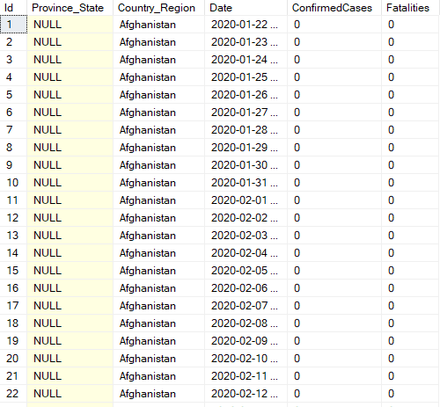
Task 1- Uploading of COVID-19.csv to DBMS
COVID-19.csv file was successfully uploaded to the DBMS - SQL SERVER.
Sample Data From Covid Table

Slide 3
TASK 2:- Using Windowing/Partition to transform the “Cumulative numbers” to “Daily Numbers”
The SQL query :
SELECT * , ConfirmedCases- LAG(ConfirmedCases,1) OVER( Partition By Country_Region,Province_State ORDER BY Date) AS "Confirmed Daily" ,Fatalities-LAG(Fatalities,1) OVER( Partition By Country_Region,Province_State ORDER BY Date) As "Fatalities Daily" FROM dbo.COVID
Important SQL Clauses and Functions Used
The PARTITION BY clause is used to divide a query’s result set into partitions, after which the WINDOW function operates on each partition separately and recalculates for each partition.
LAG() is a window function that provides access to a row at a specified physical offset which comes before the current row.
NOTE: Window Function is not supported on RDS MySQL below version 8

Slide 4
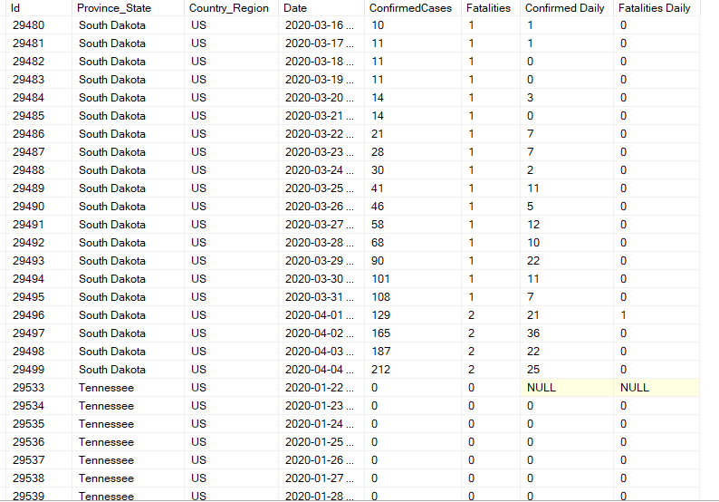
Sample Result - Task 2

Slide 5
Task-3 Aggregate "ConfirmedDaily" and "FatalitiesDaily" by "Country_Region and WeekOfYear(Date)"
The SQL query is as follows:
SELECT T.Country_Region, T.WeekOfYear, sum(T."Fatalities Daily") as "FatalitiesDaily", sum(T."Confirmed Daily") as "ConfirmedDaily" into COVID_19_aggr from (SELECT Country_Region ,DATEPART(ww,Date) As WeekOfYear, ConfirmedCases- LAG(ConfirmedCases,1) OVER( Partition By Country_Region, Province_State ORDER BY Date) AS "Confirmed Daily" , Fatalities-LAG(Fatalities,1) OVER( Partition By Country_Region,Province_State ORDER BY Date) As "Fatalities Daily" FROM dbo.COVID) as T group by T.Country_Region, T.WeekOfYear order by T.Country_Region, T.WeekOfYear
Important SQL Clauses and Functions Used
DATEPART: The DATEPART() function returns an integer which is a part of a date such as a day, month, and year.

Slide 6
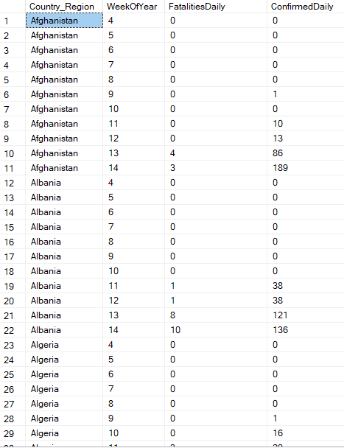
Sample Result - Task 3

Slide 7
Task 4 : Use "GROUP BY CUBE", "GROUP BY ROLLUP", and "GROUPING SETS" against "COVID_19_aggr" table.
GROUP BY CUBE
This statement creates groups for all possible combinations of the specified columns.The syntax for the GROUP BY CUBE query is:
SELECT d1, d2, aggregate_function(c4) FROM table_name GROUP BY CUBE (d1, d2);
Query:
select Country_Region, WeekOfYear, SUM(ConfirmedDaily) as ConfirmedDaily , SUM(FatalitiesDaily) as FatalitiesDaily from COVID_19_aggr group by cube (Country_Region,WeekOfYear)
GROUP BY ROLLUP
This statement creates groups of all possible combinations of the specified columns and ‘rolls up’ or provides the grand total and subtotal from the results. The syntax for the GROUP BY ROLLUP query is:
SELECT d1, d2, d3, aggregate_function(c4) FROM table_name GROUP BY ROLLUP (d1, d2, d3);
Query:
Select Country_Region, WeekOfYear, SUM(ConfirmedDaily) as ConfirmedDaily , SUM(FatalitiesDaily) as FatalitiesDaily from COVID_19_aggr group by rollup(Country_Region,WeekOfYear)

Slide 8
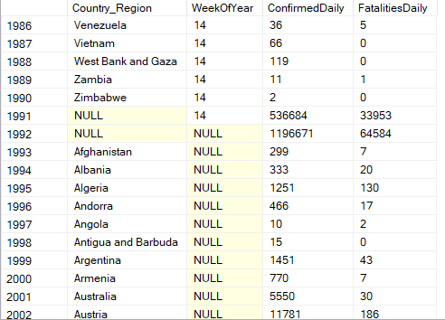
Sample Result - Task 4(Group By CUBE)

Slide 9
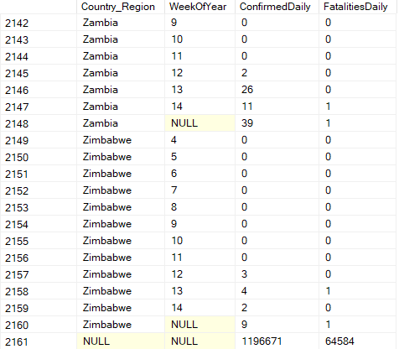
Sample Result - Task 4(Group By RollUP)

Slide 10
Task 4 (Continued): using GROUPING SETS
The SQL Query is :
select Country_Region, WeekOfYear, SUM(ConfirmedDaily) as ConfirmedDaily , SUM(FatalitiesDaily) as FatalitiesDaily from COVID_19_aggr group by GROUPING SETS ( (Country_Region), (WeekOfYear), () )
This statement provides the option to combine multiple GROUP BY clauses into a single clause. For columns c1, c2, c3 of a table, the query GROUP BY ROLLUP(c1, c2, c3) returns the same result as GROUP BY GROUPING SETS ( ROLLUP(c1, c2, c3) )

Slide 11
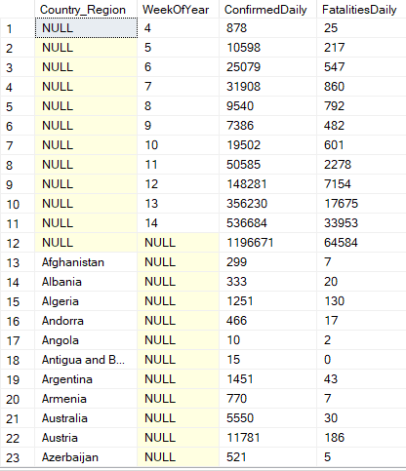
Sample Result - Task 4(Grouping Sets)

Slide 12
Task 5 : RANK() and DENSE_RANK()
The basic idea of the RANK() function is to assign a rank to each row within a partition of a result set. It adds the number of tied rows to the tied rank to calculate the next rank; hence the ranks assigned may not be consecutive.
select WeekOfYear , Country_Region, ConfirmedDaily , Rank() Over(partition by WeekOfYear order by ConfirmedDaily desc ) as Country_Rank from COVID_19_aggr order by WeekOfYear
select WeekOfYear , Country_Region, FatalitiesDaily , Rank() Over(partition by WeekOfYear order by FatalitiesDaily desc ) as Country_Rank from COVID_19_aggr order by WeekOfYear
The DENSE_RANK() function works in a similar manner as the RANK() function. The difference is that the DENSE_RANK() function returns consecutive rank values.
select WeekOfYear , Country_Region, FatalitiesDaily , Dense_rank() Over(partition by WeekOfYear order by FatalitiesDaily desc ) as Country_Rank from COVID_19_aggr order by WeekOfYear
select WeekOfYear , Country_Region, ConfirmedDaily , Dense_Rank() Over(partition by WeekOfYear order by ConfirmedDaily desc ) as Country_Rank from COVID_19_aggr order by WeekOfYear

Slide 13
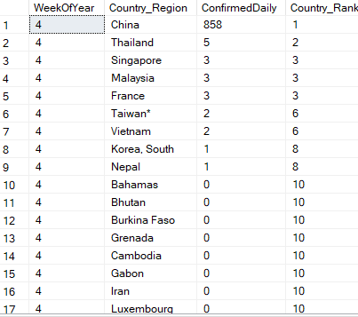
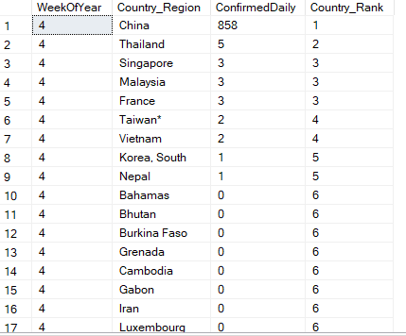
Sample Result - Task 5 (Rank and Dense Rank)
Rank
Dense Rank

Slide 14
Task 5: PERCENT_RANK() and CUME_DIST()
The basic idea of the PERCENT_RANK() function is to evaluate the relative standing of a value within a partition of a result set. It utilizes the PARTITION BY, which distributes the rows into multiple partitions, and ORDER BY clauses, which specifies the logic order of the rows in each partition. The return value of this function always lies between 0 and 1.
select WeekOfYear , Country_Region, ConfirmedDaily , Format(Percent_Rank() Over(partition by WeekOfYear order by ConfirmedDaily ),'P' ) as Country_Rank from COVID_19_aggr order by WeekOfYear , ConfirmedDaily desc
The basic idea of the CUME_DIST() function is similar to the PERCENT_RANK() function. The difference is that this function calculates the relative position of a value in group of values by calculating the cumulative distribution of that value.
select WeekOfYear , Country_Region, ConfirmedDaily , Cume_dist() Over(partition by WeekOfYear order by ConfirmedDaily desc ) as Country_Rank from COVID_19_aggr order by WeekOfYear
select WeekOfYear , Country_Region, ConfirmedDaily ,Cume_dist() Over(partition by WeekOfYear order by ConfirmedDaily ) as Country_Rank from COVID_19_aggr order by WeekOfYear , ConfirmedDaily desc

Slide 15
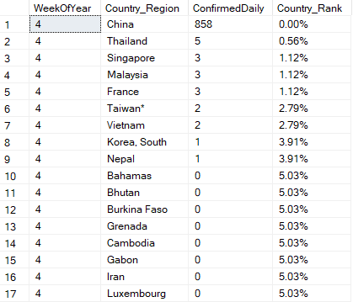
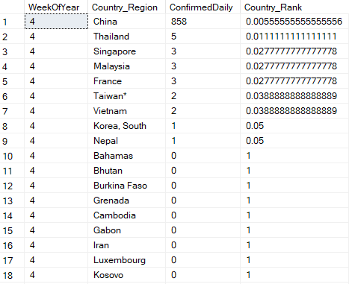
Sample Result - Task 5 (Percent_Rank and Cume_Dist )
Percent Rank
Cume_Dist()

Slide 16
Task6 : PIVOT Tables
The task was to create two PIVOT tables:
PIVOT #1:
Dimension 1: WeekOfYear
Dimension 2: Top 10 Country_Region
Measurement 1: ConfirmedDaily
The SQL Server PIVOT operator is used to turn the unique values in one column into multiple columns in the output, and performs aggregations on any remaining column values.
The steps used to create a PIVOT table are:
Select a base dataset.
Create a temporary result using a derived table
Apply the PIVOT operator
PIVOT #2:
Dimension 1: WeekOfYear
Dimension 2: Top 10 Country_Region
Measurement 2: FatalitiesDaily

Slide 17
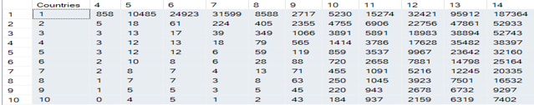
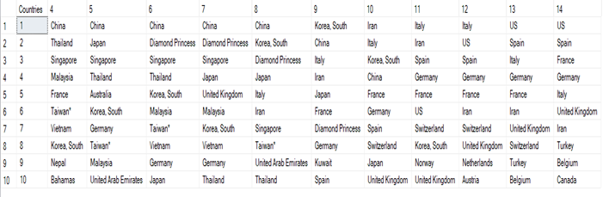
PIVOT Table 1

Slide 18
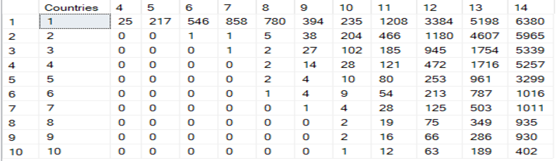
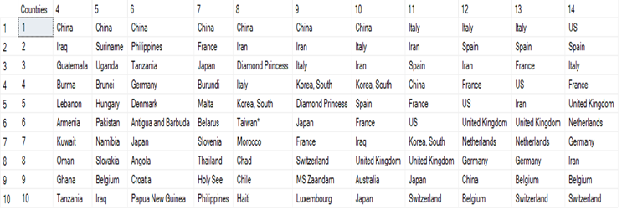
PIVOT Table 2

Slide 19
Task 7: Drill up, Drill down , Slicing, Dicing
Drill Up- is used in tasks involving subtotals.It creates subtotals at any level of aggregation needed, from the most detailed up to grand total i.e climbing up a concept hierarchy for the dimension such as time or geography.
Example:- A query could involve a ROLLUP of year >month>day or country>state>city.
Drill Down-This is a reverse of the ROLL UP operation discussed above. The data is aggregated from a higher level summary to a lower level summary/detailed data.
Slicing:-A slice in a multidimensional array is a column of data corresponding to a single value for one or more members of the dimension. It helps the user to visualize and gather the information specific to a dimension.For example, if a user wanted to know the total number of products sold across all of the market locations (Europe,North America, South America)the user would perform a horizontal slice.
Dicing:-In case of Slicing filtering is done to focus on a particular attribute. Dicing, on the other hand , is more of a zoom feature that selects a subset over all the dimensions, but for specific value of the dimension.

Slide 20
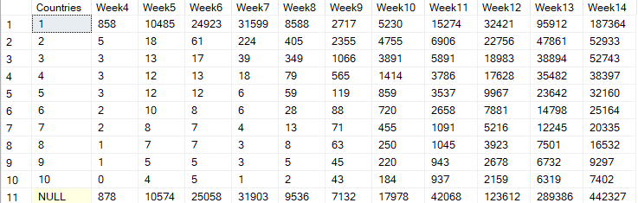
Roll-Up <-> Roll-down
Query:
select Countries , sum(piv.[4]) as Week4 ,sum(piv.[5]) as Week5,sum(piv.[6]) as Week6 ,sum(piv.[7]) as Week7 ,sum(piv.[8]) as Week8 ,sum(piv.[9]) as Week9 ,sum(piv.[10]) as Week10 ,sum(piv.[11]) as Week11 ,sum(piv.[12]) as Week12 ,sum(piv.[13]) as Week13 ,sum(piv.[14]) as Week14 from (select * from (select WeekOfYear,ConfirmedDaily , T.row as "Countries" from (select WeekOfYear,Country_Region , ConfirmedDaily , row_number() over( partition by WeekOfYear order by ConfirmedDaily desc ) as row from COVID_19_aggr) as T where T.row <=10 ) as m Pivot ( sum(ConfirmedDaily) FOR m.WeekOfYear IN ( [4], [5], [6],[7],[8],[9],[10],[11],[12],[13],[14] ) ) AS pivot_table) as piv group by rollup (Countries)

Slide 21

2. Slicing Query
Create procedure slicing (@dim bit, @number int)
as
if @dim =1
begin
select * from (select * from (select WeekOfYear,ConfirmedDaily , T.row as "Countries" from (select WeekOfYear,Country_Region , ConfirmedDaily , row_number() over( partition by WeekOfYear order by ConfirmedDaily desc ) as row from COVID_19_aggr) as T where T.row <=10 ) as m Pivot ( sum(ConfirmedDaily) FOR m.WeekOfYear IN ( [4], [5], [6],[7],[8],[9],[10],[11],[12],[13],[14] ) ) AS pivot_table) as piv where Countries = @number
end
else
begin
declare @temp int
set @temp=@number+3
select Case @temp When 4 then [4] When 5 then [5] When 6 then [6] When 7 then [7] When 8 then [8] When 9 then [9] When 10 then [10] When 11 then [11] When 12 then [12] When 13 then [13] When 14 then [14] else NULL End as "Week" from (select * from (select WeekOfYear,ConfirmedDaily , T.row as "Countries" from (select WeekOfYear,Country_Region , ConfirmedDaily , row_number() over( partition by WeekOfYear order by ConfirmedDaily desc ) as row from COVID_19_aggr) as T where T.row <=10 ) as m Pivot ( sum(ConfirmedDaily) FOR m.WeekOfYear IN ( [4], [5], [6],[7],[8],[9],[10],[11],[12],[13],[14] ) ) AS pivot_table) as piv
End

Slide 22
Results
The execution commands used to run the query is:
exec dbo.slicing @dim=0,@number=11 exec dbo.slicing @dim=1,@number=7

Slide 23

3. Dicing Query:
Create procedure dicing (@week bit, @country int) as
declare @temp int
set @temp=@week+3
select Case @temp When 4 then [4] When 5 then [5] When 6 then [6] When 7 then [7] When 8 then [8] When 9 then [9] When 10 then [10] When 11 then [11] When 12 then [12] When 13 then [13] When 14 then [14] else NULL End as "Week" from (select * from (select WeekOfYear,ConfirmedDaily , T.row as "Countries" from (select WeekOfYear,Country_Region , ConfirmedDaily , row_number() over( partition by WeekOfYear order by ConfirmedDaily desc ) as row from COVID_19_aggr) as T where T.row <=10 ) as m Pivot ( sum(ConfirmedDaily) FOR m.WeekOfYear IN ( [4], [5], [6],[7],[8],[9],[10],[11],[12],[13],[14] ) ) AS pivot_table) as piv where Countries=@country
Go
Result
The execution command used to run the query is:
Exec dbo.dicing @week=1,@country=5

Slide 24
Thank You

